Slide 1

Connected Campus
Mark Girguis, Kishan Patel, Ankit Monga,
Eric Gonzalez, Jason Chung, Hector Khuon

Slide 2
The Team | Roles
Mark Girguis - Project Manager
Kishan Patel - Programmer
Ankit Monga - Data Analyst
Eric Gonzales - Business Analyst
Jason Chung - Systems Designer
Hector Khuon - Quality Assurance

Slide 3
Functional & Non-Functional Requirements

Slide 4
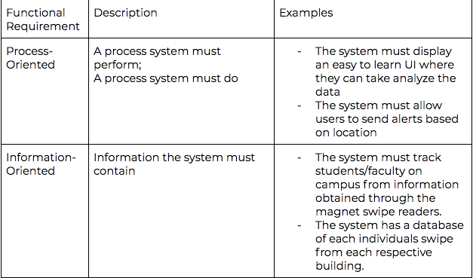
Functional Requirements

Slide 5
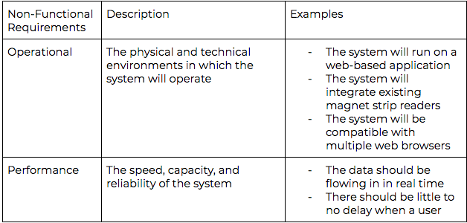
Non-Functional Requirements

Slide 6
Interviews

Slide 7
Interviews - Steven Hanna
Position of Interviewee: Forward Deployed Software Engineer (FDSE) @ Splunk
List of Questions:
Describe your understanding of the role of an FDSE in the development of Connected Campus.
What constraints do you need to be aware of in order to complete a project?
How will you handle changes in requirements?
Based on the current functionalities of the app, what desirable features would you recommend be implemented to ensure better data analytics?
Which features of the application have permission limitations? How would you maintain access control?

Slide 8
Summary of Interview - Steven Hanna
FDSE interaction with customers
Suggestions: Dashboard for online ticket sales, stadium heat map
3 Types of Access Controls:
Users: can create and edit its own saved searches, run searches, edit its own preferences, create and edit event types, and other similar tasks.
Power Users: can create and edit its own saved searches, run searches, edit its own preferences, create and edit event types, and other similar tasks.
Admin: have all the capabilities as power users, and they also can grant access to other users.

Slide 9
Interviews - Rohith Chintalapally
Position of Interviewee: Sales Engineer @ Splunk
List of Questions:
What has been the most prominent use case your customers have asked for out of Splunk?
What components of Splunk does the average user need to be aware of when understanding data flow?
What are the different parts of Splunk architecture?
How do you calculate the different types of license pricing?
When troubleshooting errors with Connected Campus, who would I reach out to?
What necessary skills are needed in order to operate the UI?

Slide 10
Summary of Interview - Rohith Chintalapally
Sales Engineer perspective
Explained the Splunk Architecture:
Forwarder
Indexer
Search Head

Slide 11
Interviews - Collin Sullivan
Position of Interviewee: Specialist Windows Administration, UMBC DoIT
List of Questions:
What has UMBC been using Splunk for?
What data sources have you been pulling in?
If you were to have 1 dashboard with the 10 most important reports to you, what would you like to see on that dashboard?
How does your current Splunk architecture look?
How big is your current Splunk license?
How many people are managing the reports daily?

Slide 12
Summary of Interview - Collin Sullivan
Rundown of Splunk at DoIT
Currently pulling data sources:
Student swipe data
Syslogs
Application logs
Message queues
Sensor data
He said the Splunk reports are generated once in the morning, and once before the COB (close of business).

Slide 13
Interviews - Jack Seuss
Position of Interviewee: VP of Information Technology, UMBC

Slide 14
Document Analysis

Slide 15
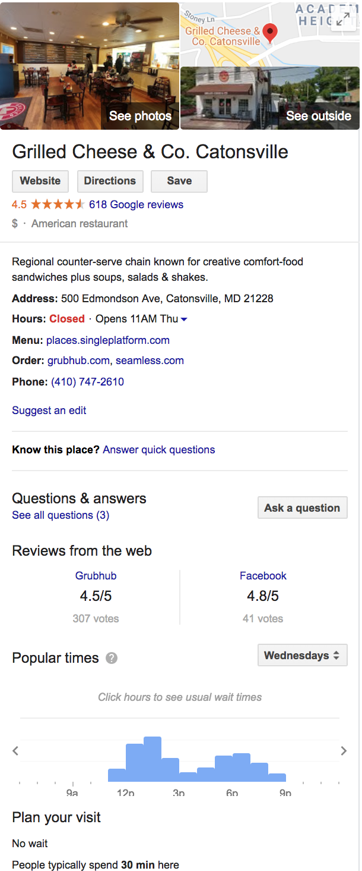
Document Analysis
For the document analysis, we decided to compare our application to Google’s new popular times feature.
Based off of the document, Google’s feature had
many similar qualities as Connected Campus.
Google’s featured used google maps to track
people’s location on Google maps to view high populated areas in a specific time.
Statistic is gathered for a variety of different uses.

Slide 16
Use Cases

Slide 17
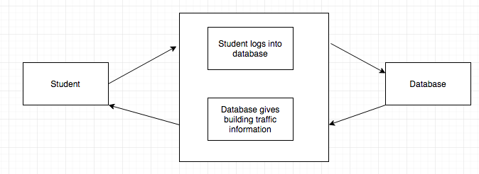
Use Case 1
Use Case 1: Student Logs into database to see if the building they are visiting has high traffic at given time
Actors:
Student
Database
Flow of Events:
Use case starts when Student logs in
The system searches traffic information from swipe data
Student checks traffic information
The Database gives traffic info
Use Case ends.

Slide 18
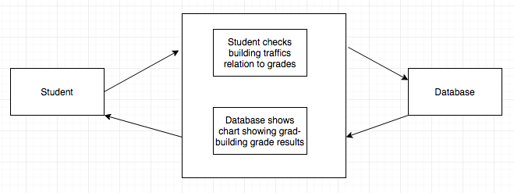
Use Case 2
Use Case 2: Student checks what time visiting a building is resulting in higher grades
Actors:
Student
Database
Flow of Events:
Use case starts when Student searches correlation between building traffic and grades
The system searches data for traffic and grades of students and finds which building is resulting in higher grades
Student checks report
Use Case ends.

Slide 19
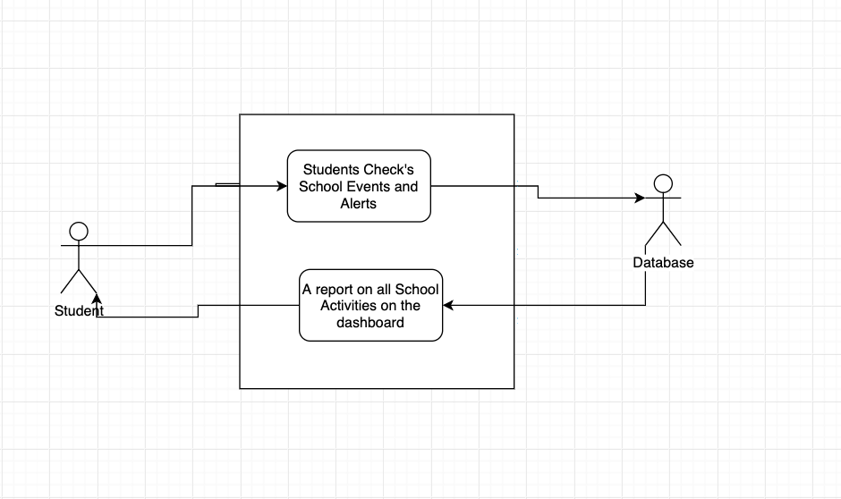
Use Case 3
Use Case 3: Students Checks what events and alerts are happening around the school at a given time.
Actors:
Student
Database
Flow of Events:
Use case starts when Student swipes card.
The system then records student record.
Student checks school events and alerts
The Database retrieves reports
Use Case ends

Slide 20
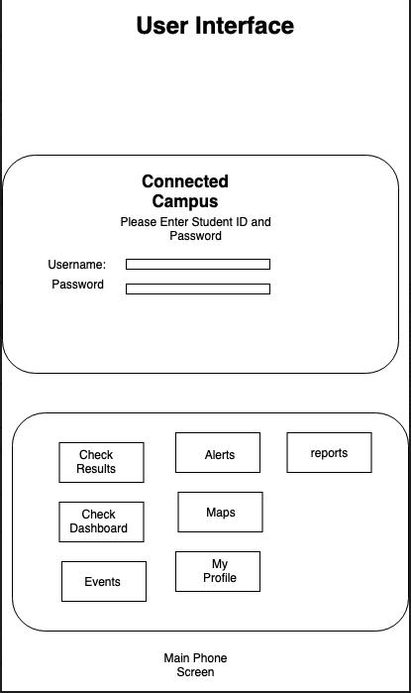
Use Case 4
Use Case 4: (Log in)Proposed User Interface for mobile application version of Connected campus
Actors:
Students
Admin
Flow of events:
Use Case Starts when Student Opens the Mobile Application
Student then log in with ID and password
Student then selects the different application options.
Case use end.
Scenarios
· Bad User Name
· Bad password
· Too many attempts to log in, account on hold
· Admin has the control for students logins.

Slide 21
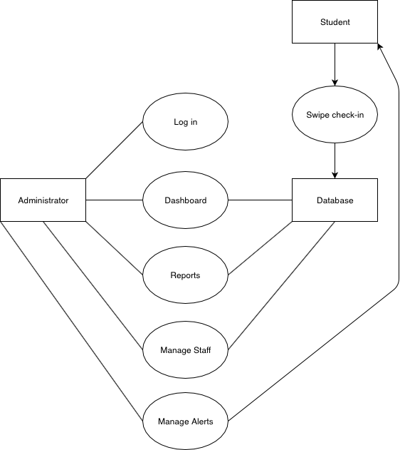
Use Case 5
Use Case 5: (Administrator View) As students swipe to check-in, administrators can log in and view real-time data through the dashboard and check reports on all areas of the campus. Based on the information, staff changes can be made and alerts will be sent to students accordingly.
Actors:
Student
Administrator
Database
Preconditions:
Database is successfully storing student data in real-time and up-to-date
Administrator identity is authenticated
Postconditions:
Dashboard retrieves data
Reports are produced for administrator
Staff and students alerted

